Slide 1
What to Evaluate?
iterative design and evaluation is a continuous process that examines: early ideas for a conceptual model; early prototypes of the new system; later, more complete prototypes
Designers need to check that they understand users' requirements
Users want systems that are easy to learn and to use as well as effective, efficient, safe, and satisfying. Being entertaining, attractive, and challenging, etc. is also essential for some products.
So, knowing what to evaluate, why it is important, and when to evaluate are key skills for interaction designers.

Slide 2
Why Evaluate?
because user experience can be extremely important for a product's success
- because the cycle of design and testing is the only validated methodology in existence that will consistently produce successful results
Five good reasons for investing in user testing (Tognazzini):
- fixed problems before the product is shipped - the team can concentrate on real problems - Engineers code instead of debating - Reduced time to market - sell without bothering to release patches

Slide 3
When to Evaluate
when it's brand new: develop markups of the product to elicit reactions from the potential users
upgrades: compare user performance & attitude w/ previous versions

Slide 4
Evaluation Methods
Formative Evaluation: done at different stages of development to check that the product meets users needs
Summative Evaluation: assess the quality of a finished product
it is best to evaluate throughout design- from the first descriptions / sketches, all the way to the final product
Design proceeds through iterative cycles of design / test / re-design - where evaluation is a key ingredient for a successful design

Slide 5
An Evaluation Framework / Evaluation Paradigms
User studies focus on how people behave, in their natural environments, or in the laboratory, with old technologies and with new ones.
any kind of evaluation is guided by a set of beliefs, implicitly or explicitly.
These beliefs are often supported by a theory. The beliefs and the methods associated with them are called evaluation paradigms.
There are four main evaluation paradigms discussed:
Quick & Dirty:
this is the common practice by which designers get feedback from users, to confirm that they are in line with users' needs and are liked. Emphasis is on fast input to the design process rather than carefully documented findings.
Usability Testing:
records typical users' performance on typical tasks in controlled settings. As the users perform the tasks they are watched and recorded on video, with keypresses logged. Data is used to calculate performance times, identify errors and help explain why the users did what they did.
User satisfaction questionnaires & interviews are used to gather users' opinions.

Slide 6
An Evaluation Framework / Evaluation Paradigms (Contd.)
Field Studies:
done in natural settings- aims to understand what users do naturally and how technology impacts them. This can help to:
identify opportunities for new technology
determine design requirements
decide how best to introduce new technology
evaluate technology in use
Predictive Evaluation:
experts apply their knowledge of typical users to predict usability problems
can involve heuristics, and theoretically based models
users do not need to be present, and this method is cheap and quick to do
GOMS / KLM / Fitt's Law???

Slide 7
Evaluation Techniques
Observing users
can help identify needs, which can lead to new products
can help evaluate prototypes
ways in which to record observations: notes, audio, video, interaction logs
challenges: how can we observe others without disturbing them? how will we analyze the data gathered?
Asking users their opinions
Techniques: Interviews and Questionnaires
Asking experts their opinions is inexpensive and quick
Testing users' performance
ways to measure user performance to compare 2 or more designs
modeling users' task performance to predict the efficacy and problems of a user interface
some of these techniques: GOMS and the keystroke model

Slide 8
DECIDE: A framework to guide evaluation
Determine the goals the evaluation addresses (what, who, why...)
Explore the specific questions to be addressed (break down into sub questions- e.g. consumers' attitudes, security, interface, reputation of system, trust, adequate access)
Choose the evaluation paradigm and techniques to answer the questions (paradigm selected determines the techniques used. Practical issues, ethical issues, and tradeoffs must be considered)
Identify the practical issues (select users, stay on budget, stay on schedule, find evaluators, select equipment)
Decide how to deal with the ethical issues (informed consent form, privacy / confidentiality, and let the participants know the goals of the study, what will happen to the findings, privacy of information, etc..)
Evaluate, interpret, and present the data (what data to collect, how to analyze and present depends on the paradigm used. Need to consider reliability, validity, biases, scope and ecological validity)

Slide 9
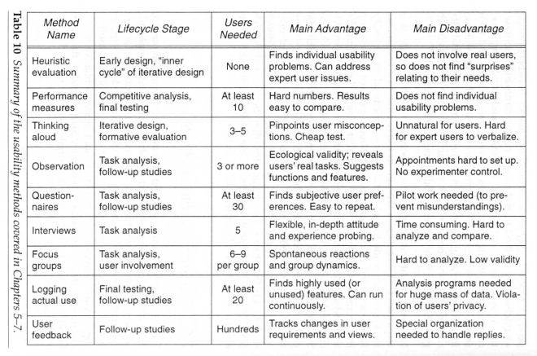

Slide 10
References
http://www.sharritt.com/CISHCIExam/preece.html

